Slide 1



Predicting Bottomhole Temperatures in Wells
PETR 6397
BIG DATA ANALYTICS
GROUP 9 Team Members:
- Azharmadani Syed 2316906
- Durga Devi Chikkala 2290061
- Likhitha Reddy Kesara 2296664
- Guna sekhar Siddabathuni 2312120
- Suguna Chandana 2311362
- Sandeep Kokkula 2102358

Slide 2

Contents
Business Objective
Importance & Challenges in predicting BHT.
Data Preprocessing
Exploratory Data Analysis
Model Building
Feature Selection
Hyperparameter Tuning
Model Validation
Conclusion

Slide 3
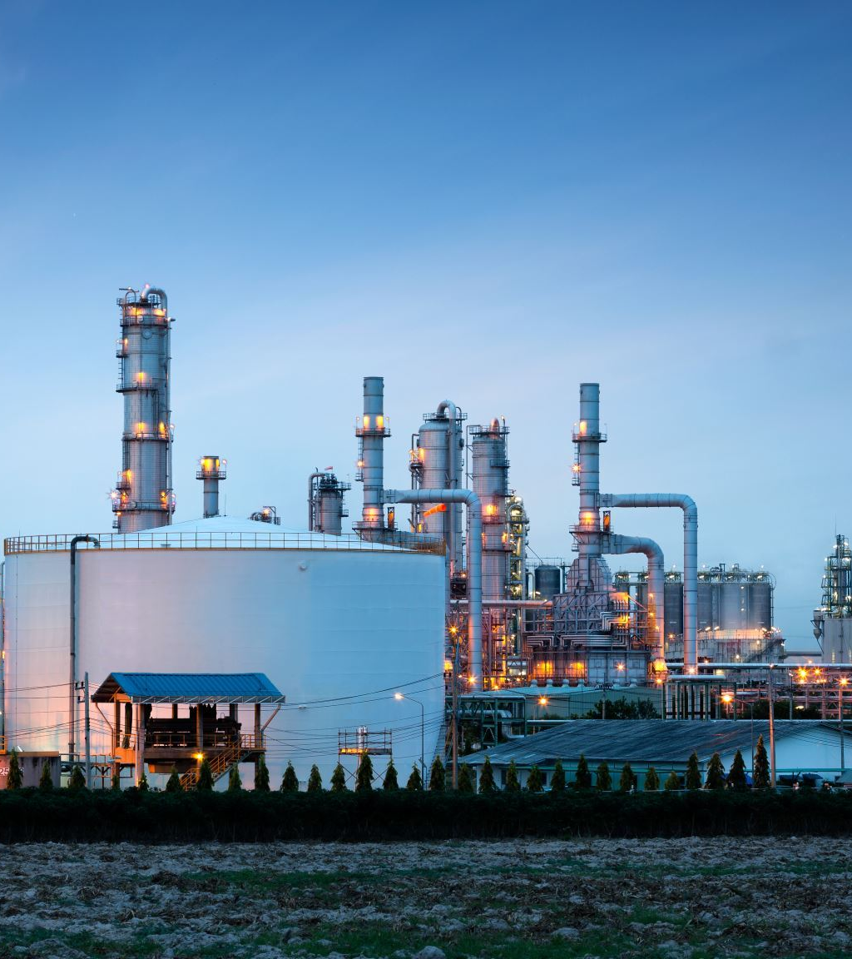
Business Objective
The core objective appears to be the prediction of Bottom Hole Temperatures (BHT) in a drilling environment.
BHT is a crucial parameter in various geothermal and petroleum engineering applications, influencing equipment selection, operational strategies, and safety measures.

Slide 4
Importance and challenges
Reservoir Management
Equipment Design
Safety and Efficiency
Extreme Conditions
High Temperature/High Pressure(HT/HP) Wells
Fluid Behavior

Slide 5

Data Analysis
Data Preprocessing
Analyzing missing values.
Outlier detection
Distribution of the variables
Data Discrepancy
Exploratory Data Analysis
Correlation

Slide 6
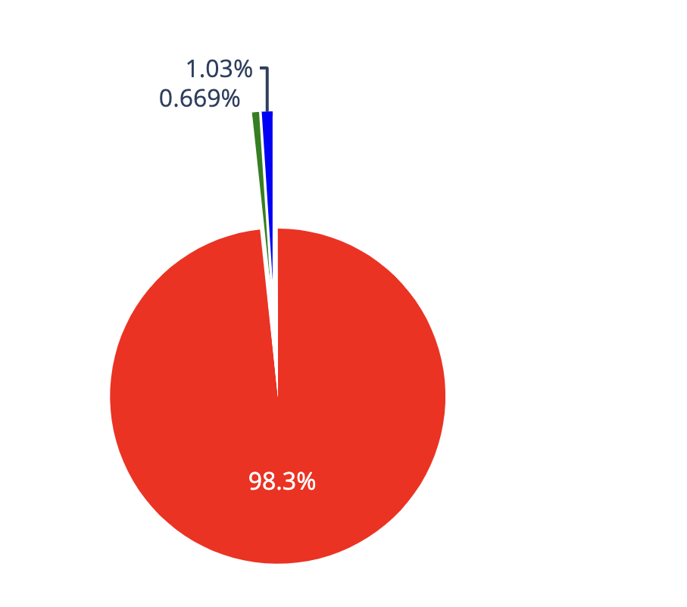
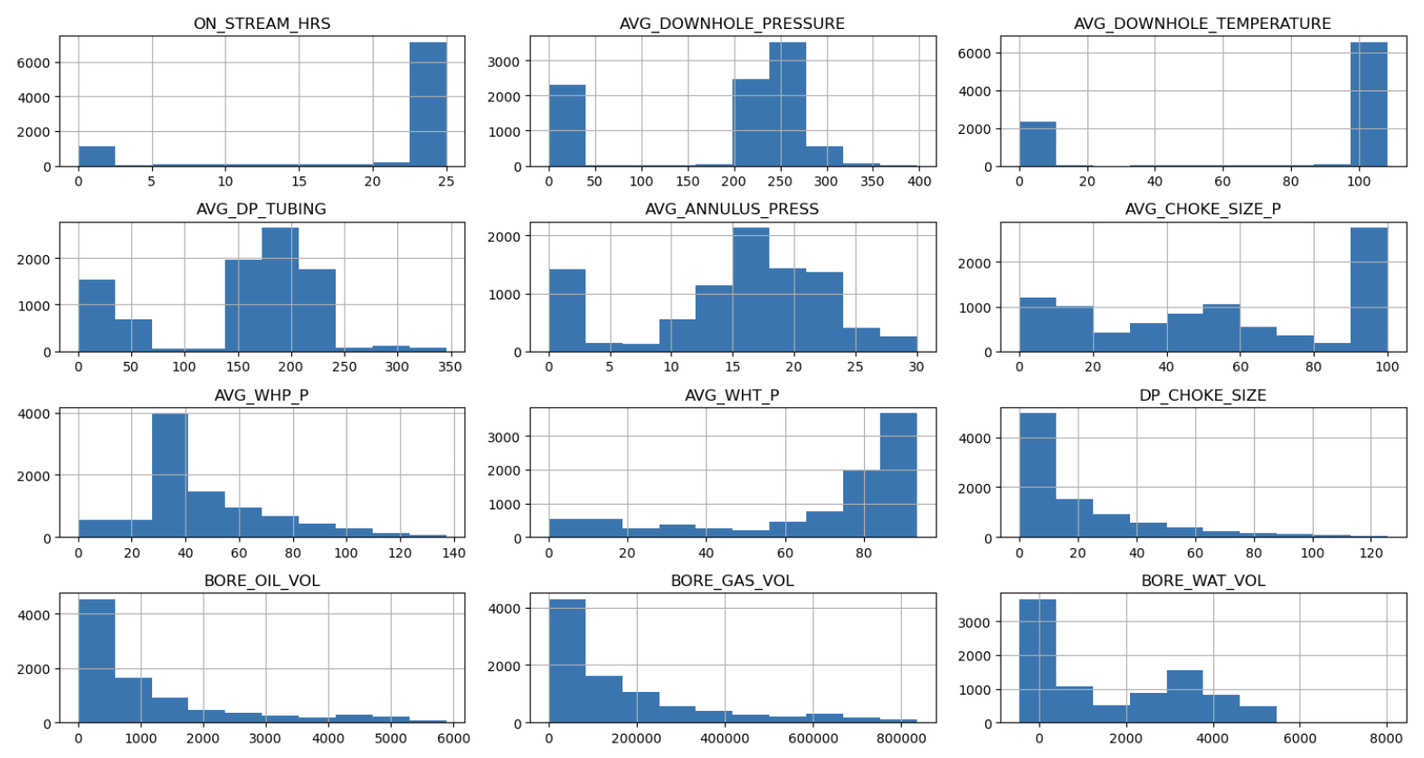

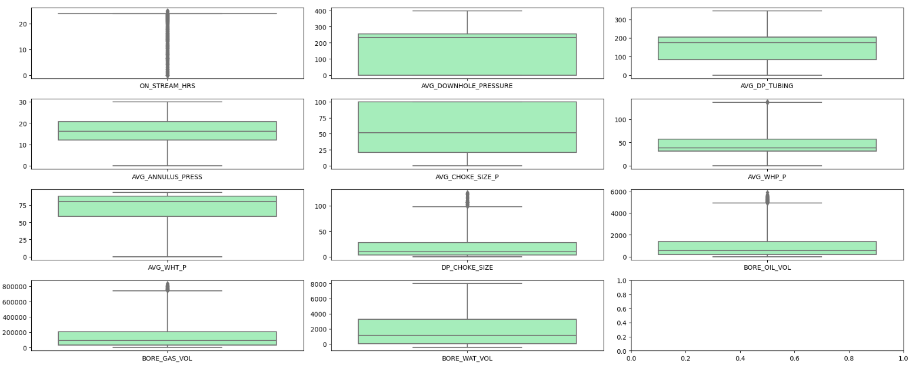
DATA DISTRIBUTION AND OUTLIERS

Slide 7
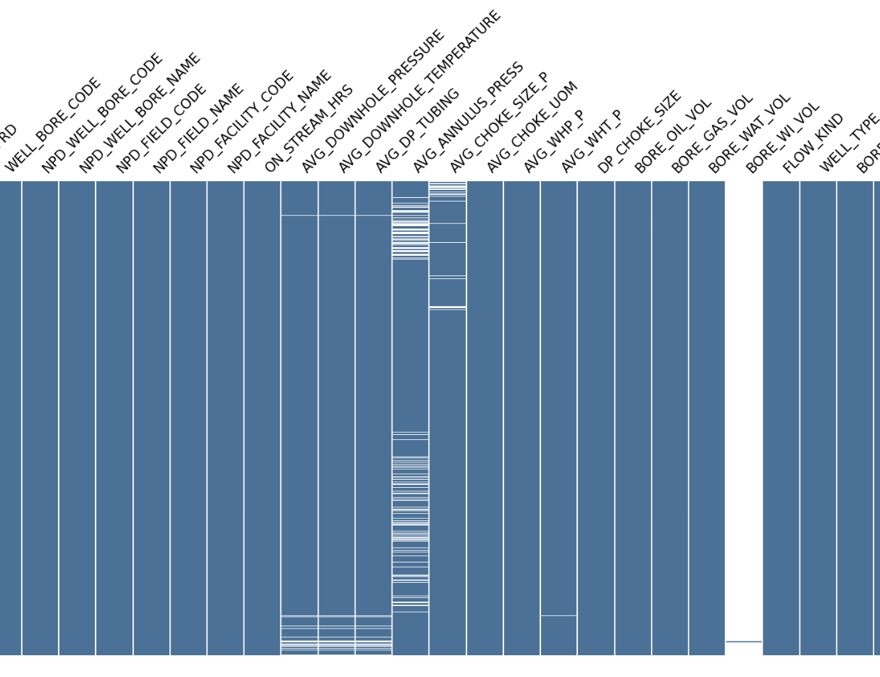
Missing Values
Missing data matrix for a dataset:
The matrix illustrates the completeness of the dataset across various fields.
White lines indicate missing values, while the blue represents non-missing data.
Most fields show full data completeness except for a few with significant missing entries.
The `FLOW_KIND` and `WELL_TYPE` fields, among others, have some missing values.
Data sparsity is more apparent in fields towards the right side of the matrix.

Slide 8
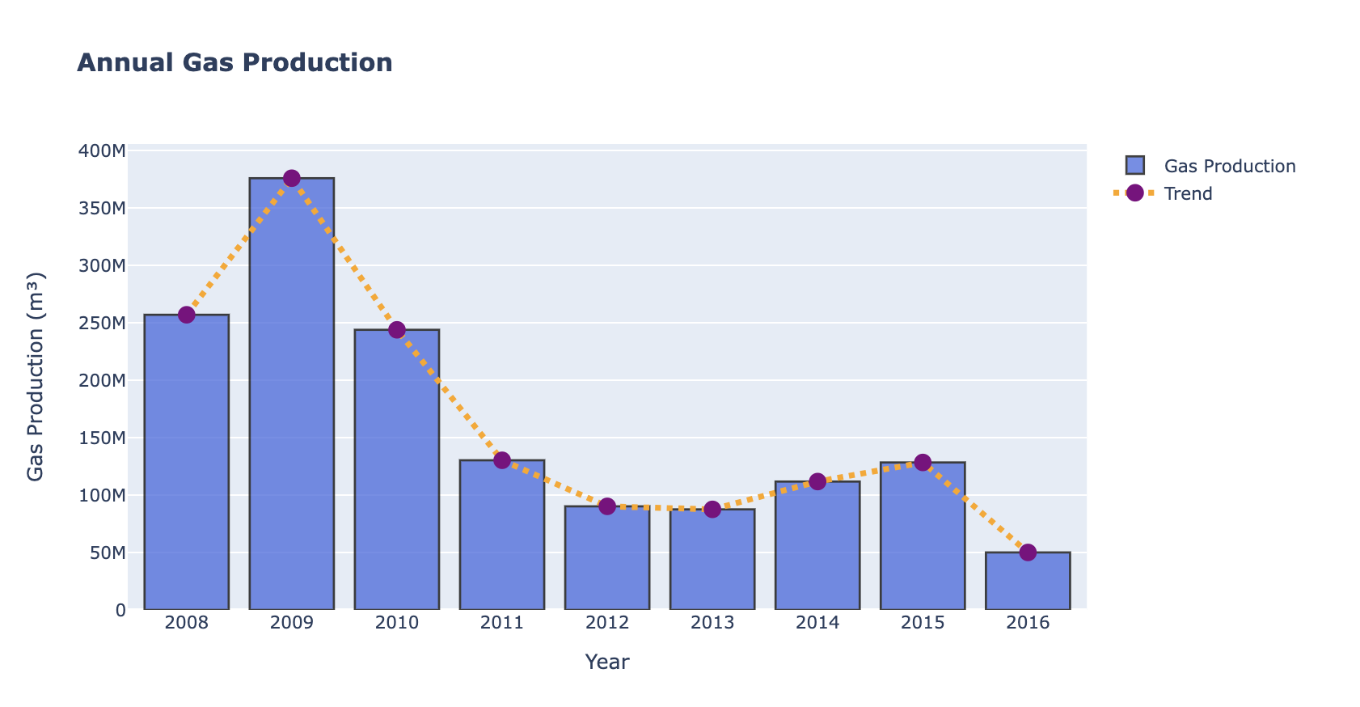
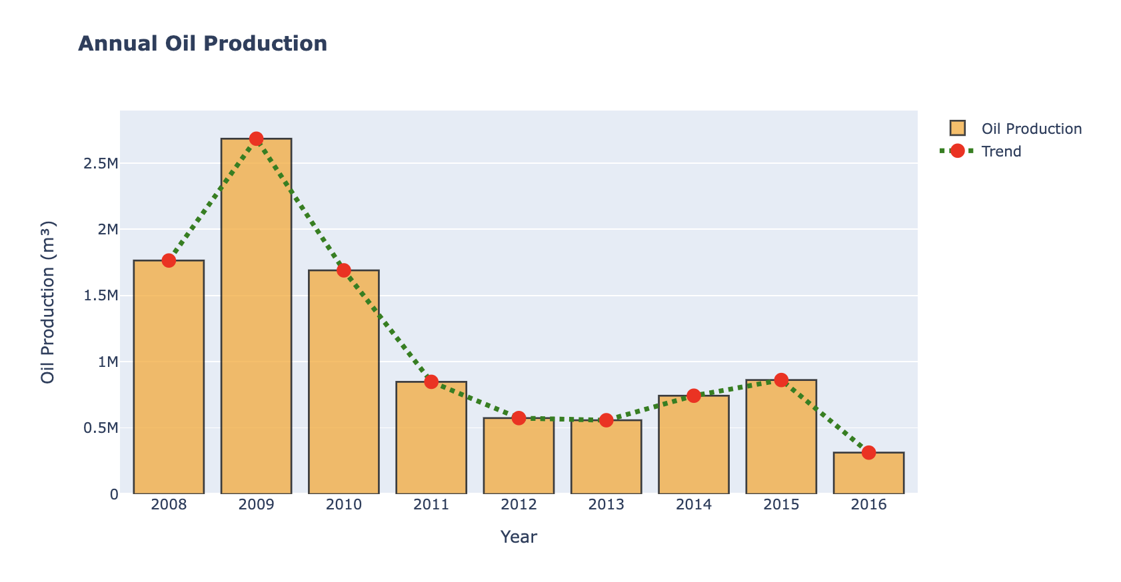
Annual Gas Production (2008-2016):
Peak production in 2010.
Steady decline post-peak.
Downtrend with minor recoveries.
Annual Oil Production (2008-2016):​
Highest production in 2009.​
Sharp fall until 2012.​
Gradual decrease with relative stability thereafter.​

Slide 9
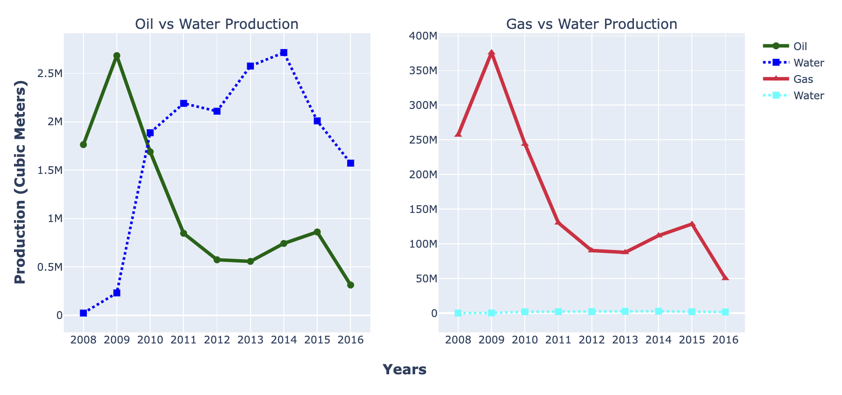
Oil vs Water Production (2008-2016): - Oil production peaked in 2009, then fluctuated before a steady decline. - Water production shows less volatility, with a notable increase in 2012.
Gas vs Water Production (2008-2016): - Gas production hit its highest point in 2009, followed by a sharp decline. - Minimal water production throughout, with relatively stable levels compared to gas.

Slide 10
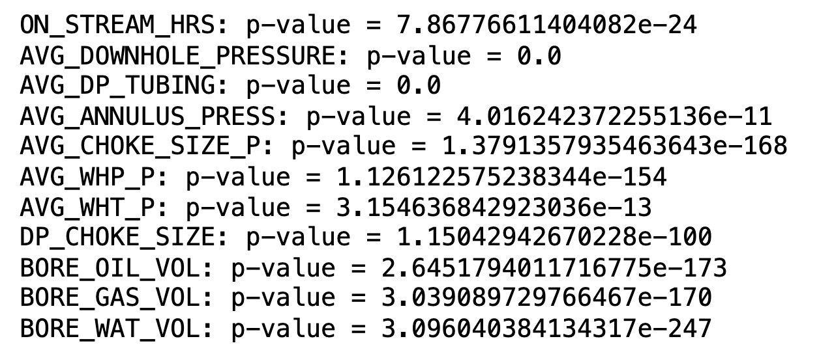
Statistical test – PEARSON
The image provided lists p-values for various variables, likely from a statistical analysis:
ON_STREAM_HRS: Highly significant (p < 0.0001)
AVG_DOWNHOLE_PRESSURE: Extremely significant (p = 0.0) AVG_DP_TUBING: Extremely significant (p = 0.0) AVG_ANNULUS_PRESS: Highly significant (p < 0.05) AVG_CHOKE_SIZE_P: Extremely significant (p << 0.0001)
AVG_WHP_P: Extremely significant (p << 0.0001)
AVG_WHT_P: Very significant (p < 0.01)
DP_CHOKE_SIZE: Extremely significant (p << 0.0001)
BORE_OIL_VOL: Extremely significant (p << 0.0001)
BORE_GAS_VOL: Extremely significant (p << 0.0001)
BORE_WAT_VOL: Extremely significant (p << 0.0001)
All listed variables show statistical significance, with most showing extreme significance, suggesting strong evidence against the null hypothesis in the context of the analysis performed.

Slide 11
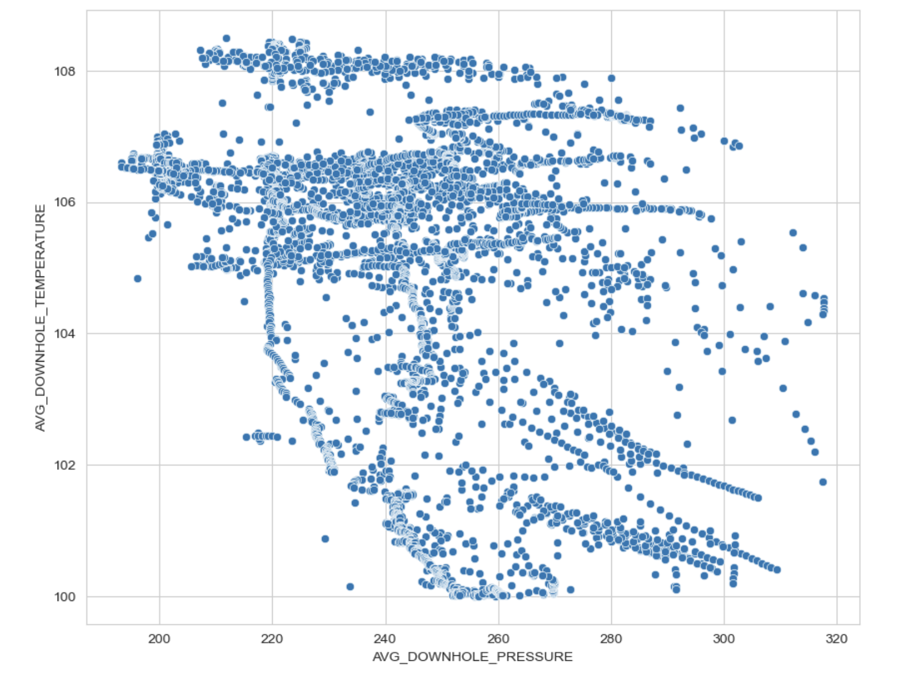
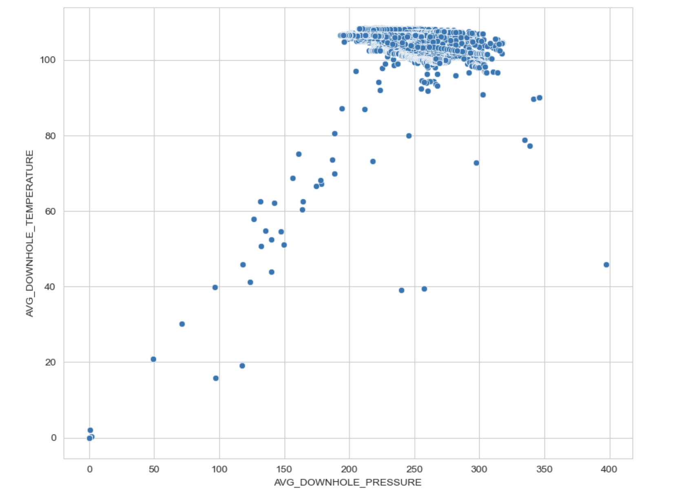
DATA DISCRIPENCY
(Low Pressure and Temperature Range)
(Higher Pressure and Temperature Range)

Slide 12
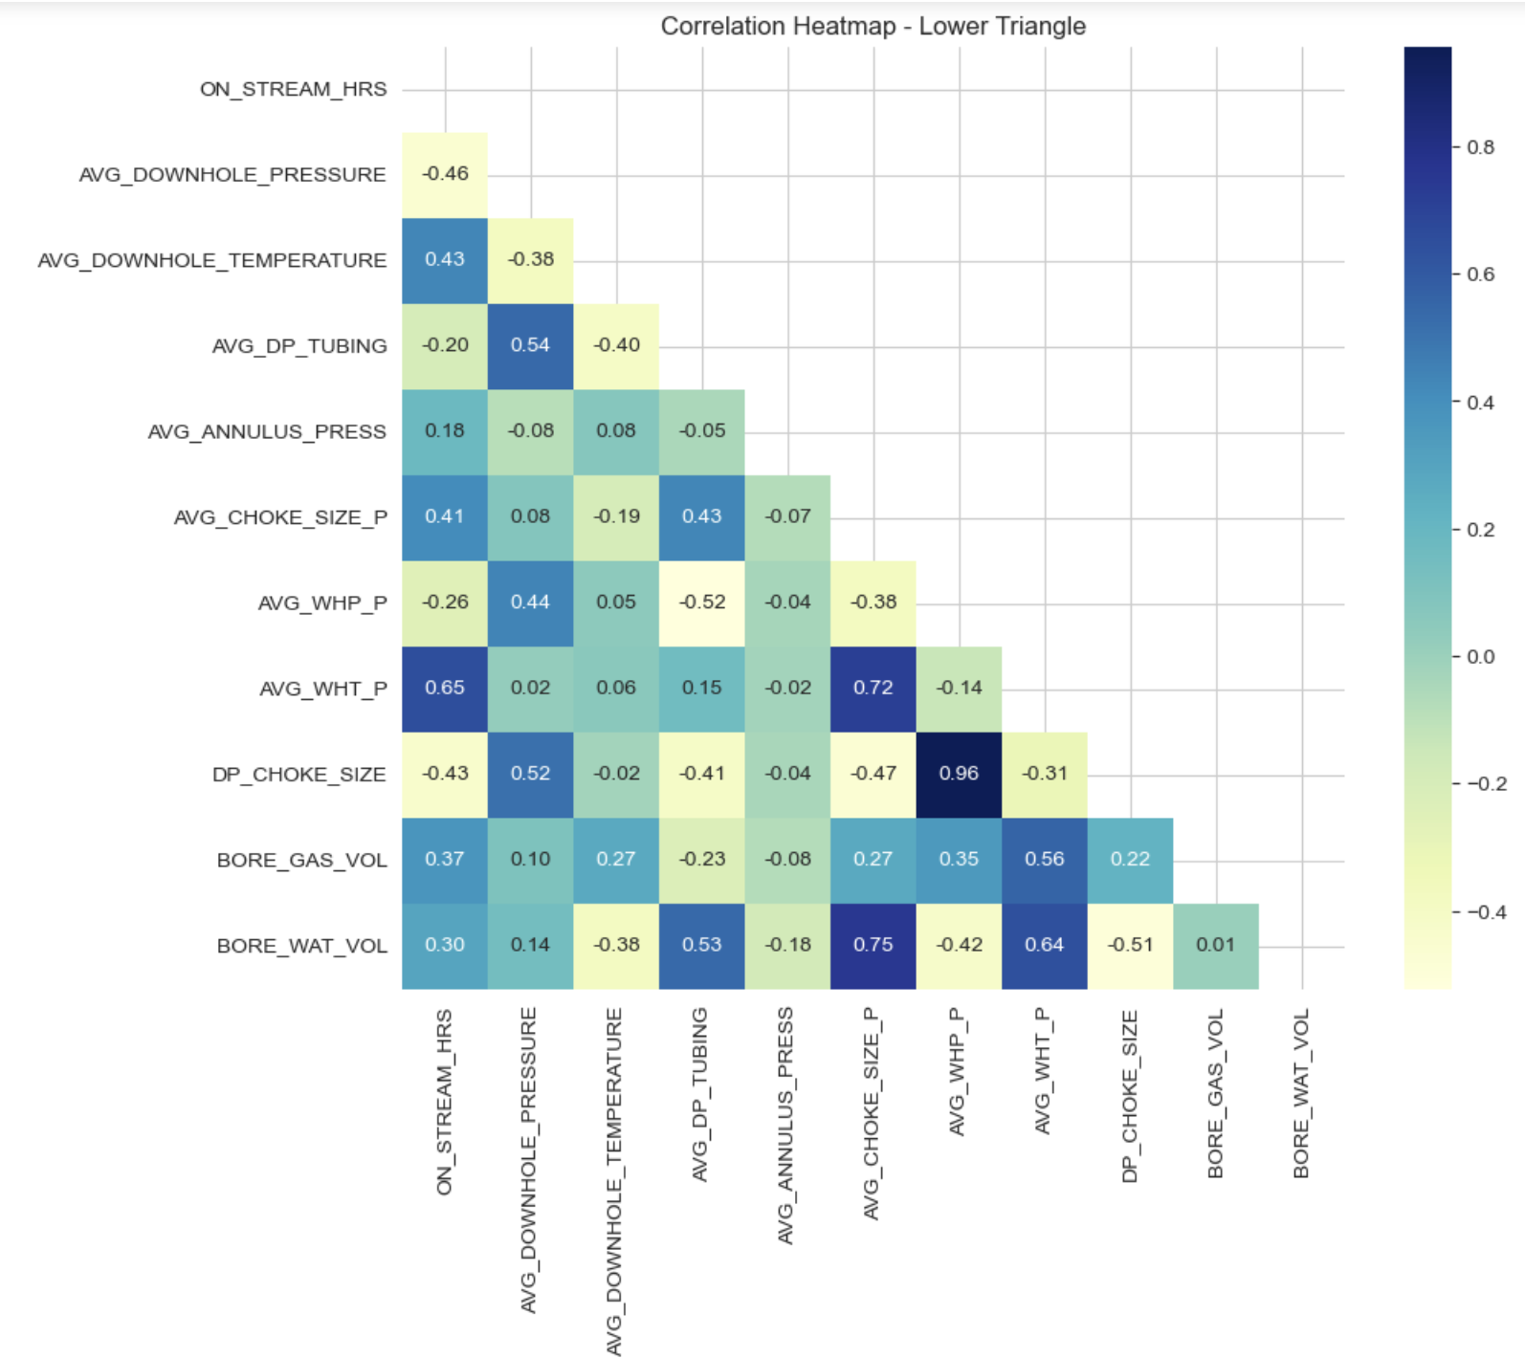
Correlation
High correlation between Temperature and Pressure.
Also, high correlation between AVG_DP_TUBING and Pressure.
There is good amount of Multicollinearity in the data.

Slide 13
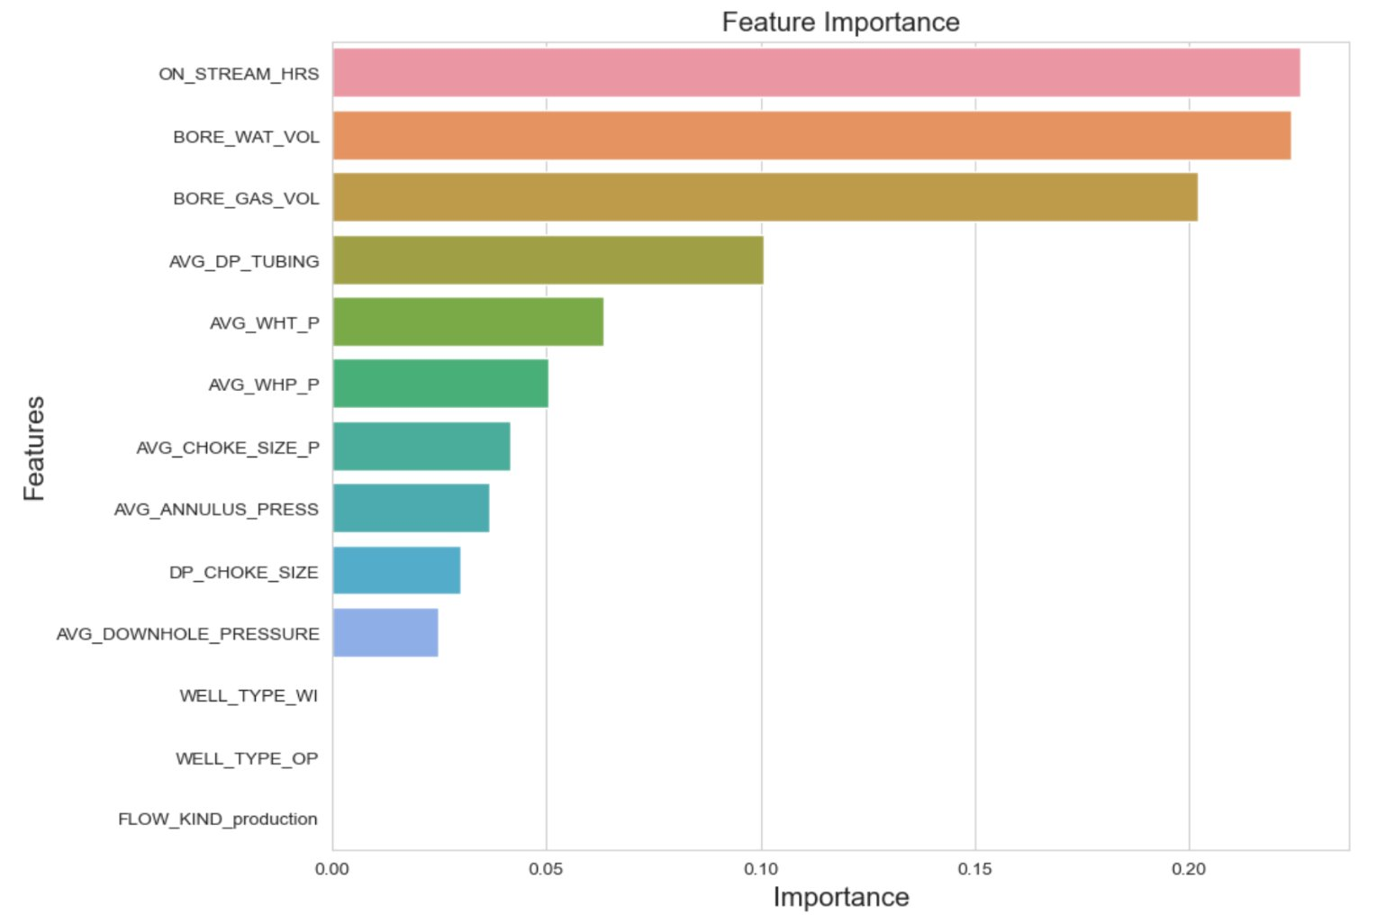
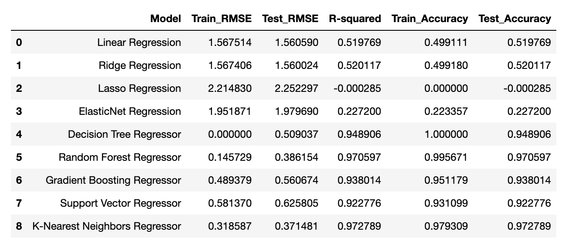
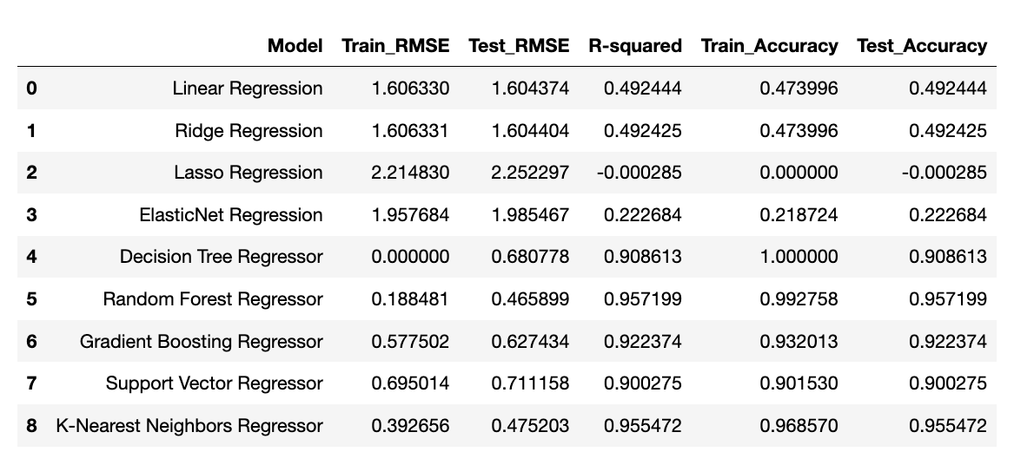
SCORECARDS
Using all Features:
When we observe the above models, then we can interpret that few models are having good accuracies but high overfitting.
Random Forest, Decision Tree and SVR, these models are having good R2 and high accuracy but these models are overfitting as well.
Here the KNN Regressor has outperformed all the other models.
It has good accuracies, R2 score and less overfitting as well.
The above four models have performed very poor for our dataset.

Slide 14
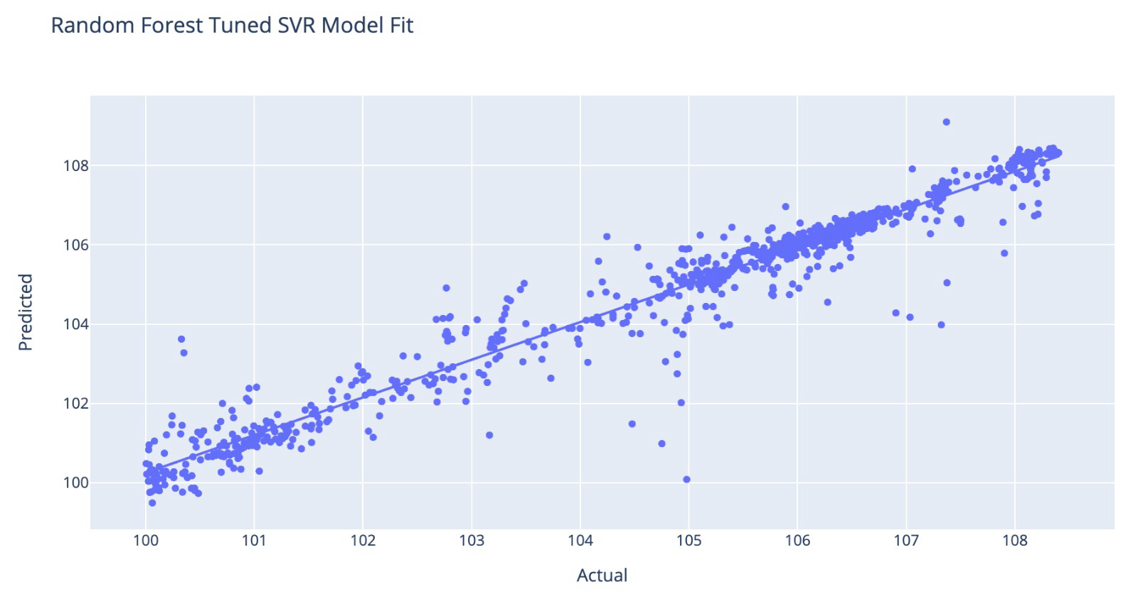
Hyperparameter tuning
Best parameters for Random Forest Regressor: {'max_depth': None, 'min_samples_leaf': 1, 'min_samples_split': 2, 'n_estimators': 50}
Best parameters for Gradient Boosting Regressor: {'learning_rate': 0.1, 'max_depth': 5, 'min_samples_leaf': 2, 'min_samples_split': 2, 'n_estimators': 100, 'subsample': 1.0}
Best parameters for SVR: {'C': 10, 'gamma': 'scale', 'kernel': 'rbf'}
Tuned SVR model

Slide 15
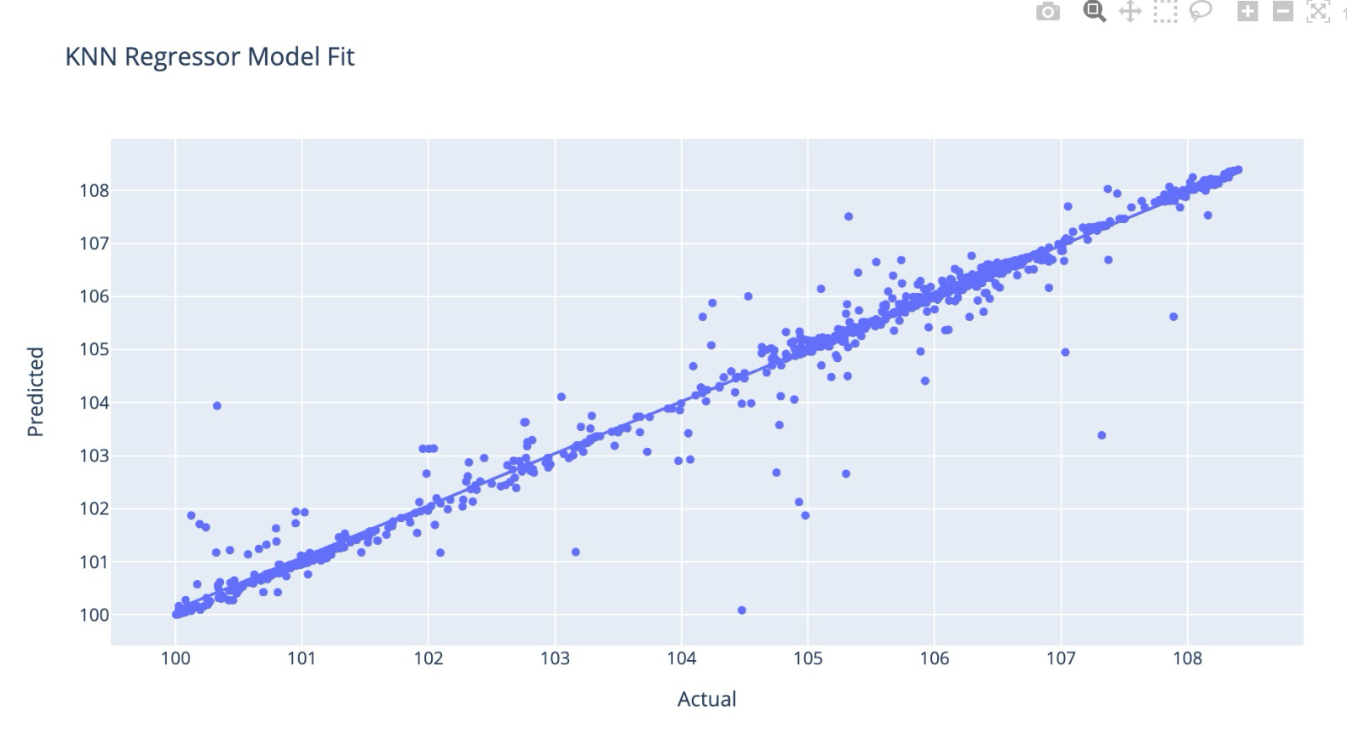
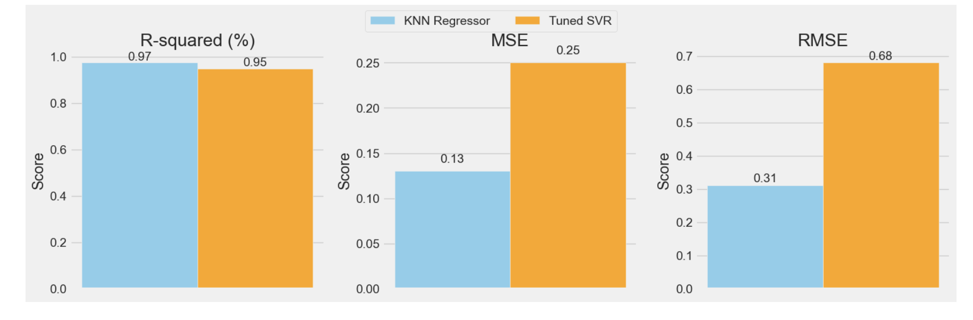
Best model (svr vs knn)
KNN Regressor:
R-squared: 0.97, indicating excellent model fit.
MSE (Mean Squared Error): 0.13, indicating low average squared error.
RMSE (Root Mean Squared Error): 0.31, low error magnitude.
Tuned SVR (Support Vector Regression):
R-squared: 0.95, very good model fit, slightly lower than KNN.
MSE: 0.25, higher average error than KNN.
RMSE: 0.68, higher error magnitude than KNN.
Overall, the KNN Regressor outperforms the Tuned SVR on all three metrics, suggesting it may be the more accurate model for this particular prediction task.

Slide 16

CONCLUSION
The conclusion highlights the successful application of data analysis on the Volve field dataset, where through careful data handling and visualization, key feature relationships were uncovered.
Despite challenges such as missing data, strategic imputation improved the dataset's quality, leading to a robust machine-learning model capable of predicting well performance and optimizing operations.
It emphasizes that while current findings are substantial, continuous exploration with advanced analytics could yield deeper insights. This case exemplifies the transformative impact of data-driven methodologies in enhancing efficiency and sustainability within the oil and gas sector.

Slide 17

THANK YOU

